Slide 1



Introduction to Robotics
DR/ Ahmed Zakaria
TA/Ahmed Tarek
TA/Ahmed Abd El Latif
TA/Omar Khaled

Slide 2
Robotics
Robotics is a branch of engineering and computer science that involves the conception, design, manufacture and operation of robots. The objective of the robotics field is to create intelligent machines that can assist humans in a variety of ways.

Slide 3
Why do we use robots
Robots can ensure better accuracy within the workplace, which reduces the likelihood of human error.
Robots are used in multiple areas, especially where they can alleviate strenuous tasks or complete missions that are dangerous for a human to undertake.

Slide 4
Things needed for building a robot
Hardware: like sensors , leds , displays , motor ….etc.
Software : building robot isn’t enough you need to program it to work in certain way depending on your tasks
And for this course we will be working with Arduino

Slide 5
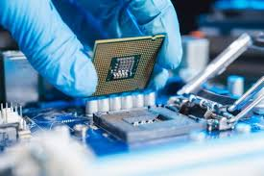
Microprocessor
A microprocessor is a controlling unit of a micro-computer wrapped inside a small chip. It performs Arithmetic Logical Unit (ALU) operations and communicates with the other devices connected with it. It is a single Integrated Circuit in which several functions are combined.

Slide 6
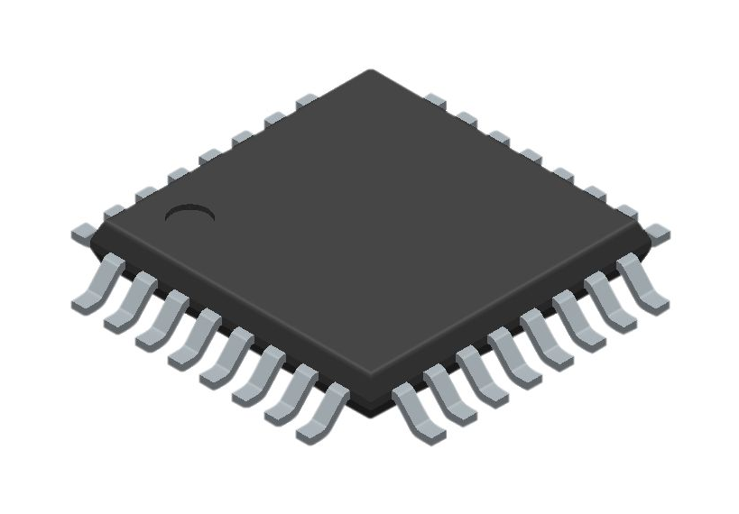
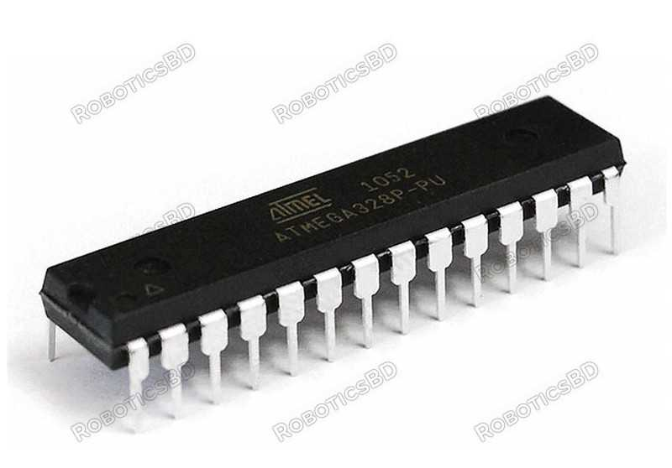
Microcontroller
A microcontroller is a chip optimized to control electronic devices. It is stored in a single integrated circuit which is dedicated to performing a particular task and execute one specific application.
It is specially designed circuits for embedded applications and is widely used in automatically controlled electronic devices. It contains memory, processor, and programmable I/O.

Slide 7
Microprocessor Vs Microcontroller
Microprocessor consists of only a Central Processing Unit, whereas Micro Controller contains a CPU, Memory, I/O all integrated into one chip.
Microprocessor is used in Personal Computers whereas Micro Controller is used in an embedded system.

Slide 8
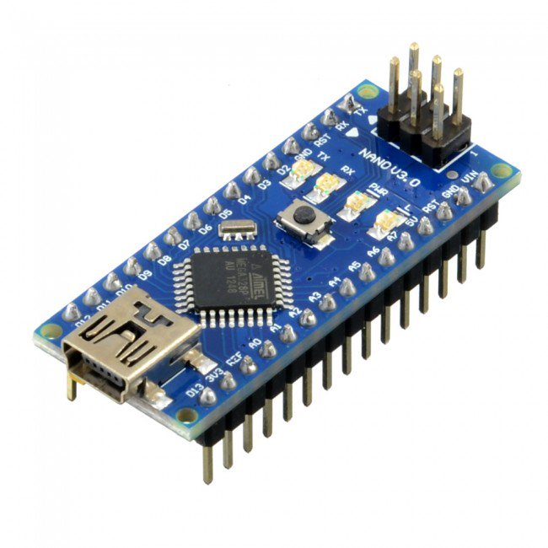
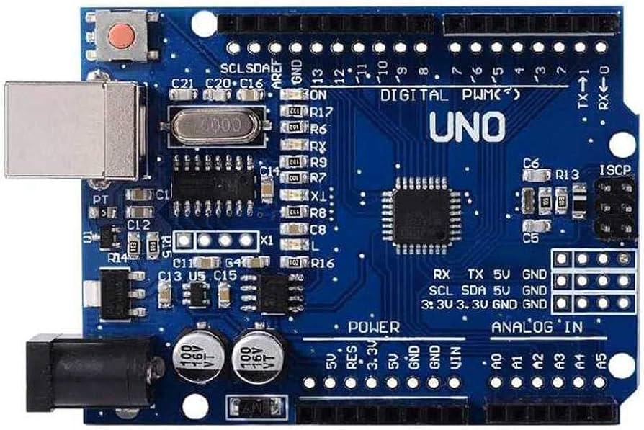
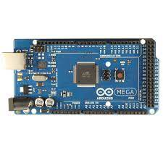
Arduino
What will we study is Arduino

Slide 9
Arduino
Arduino is an open-source hardware and software platform that is commonly used for creating interactive electronic projects. It consists of both a physical microcontroller board (hardware) and a development environment (software) that allows users to program and control a wide variety of electronic components, such as sensors, motors, LEDs, and more.
Arduino will be powered by Arduino IDE and for it’s programming language c++

Slide 10
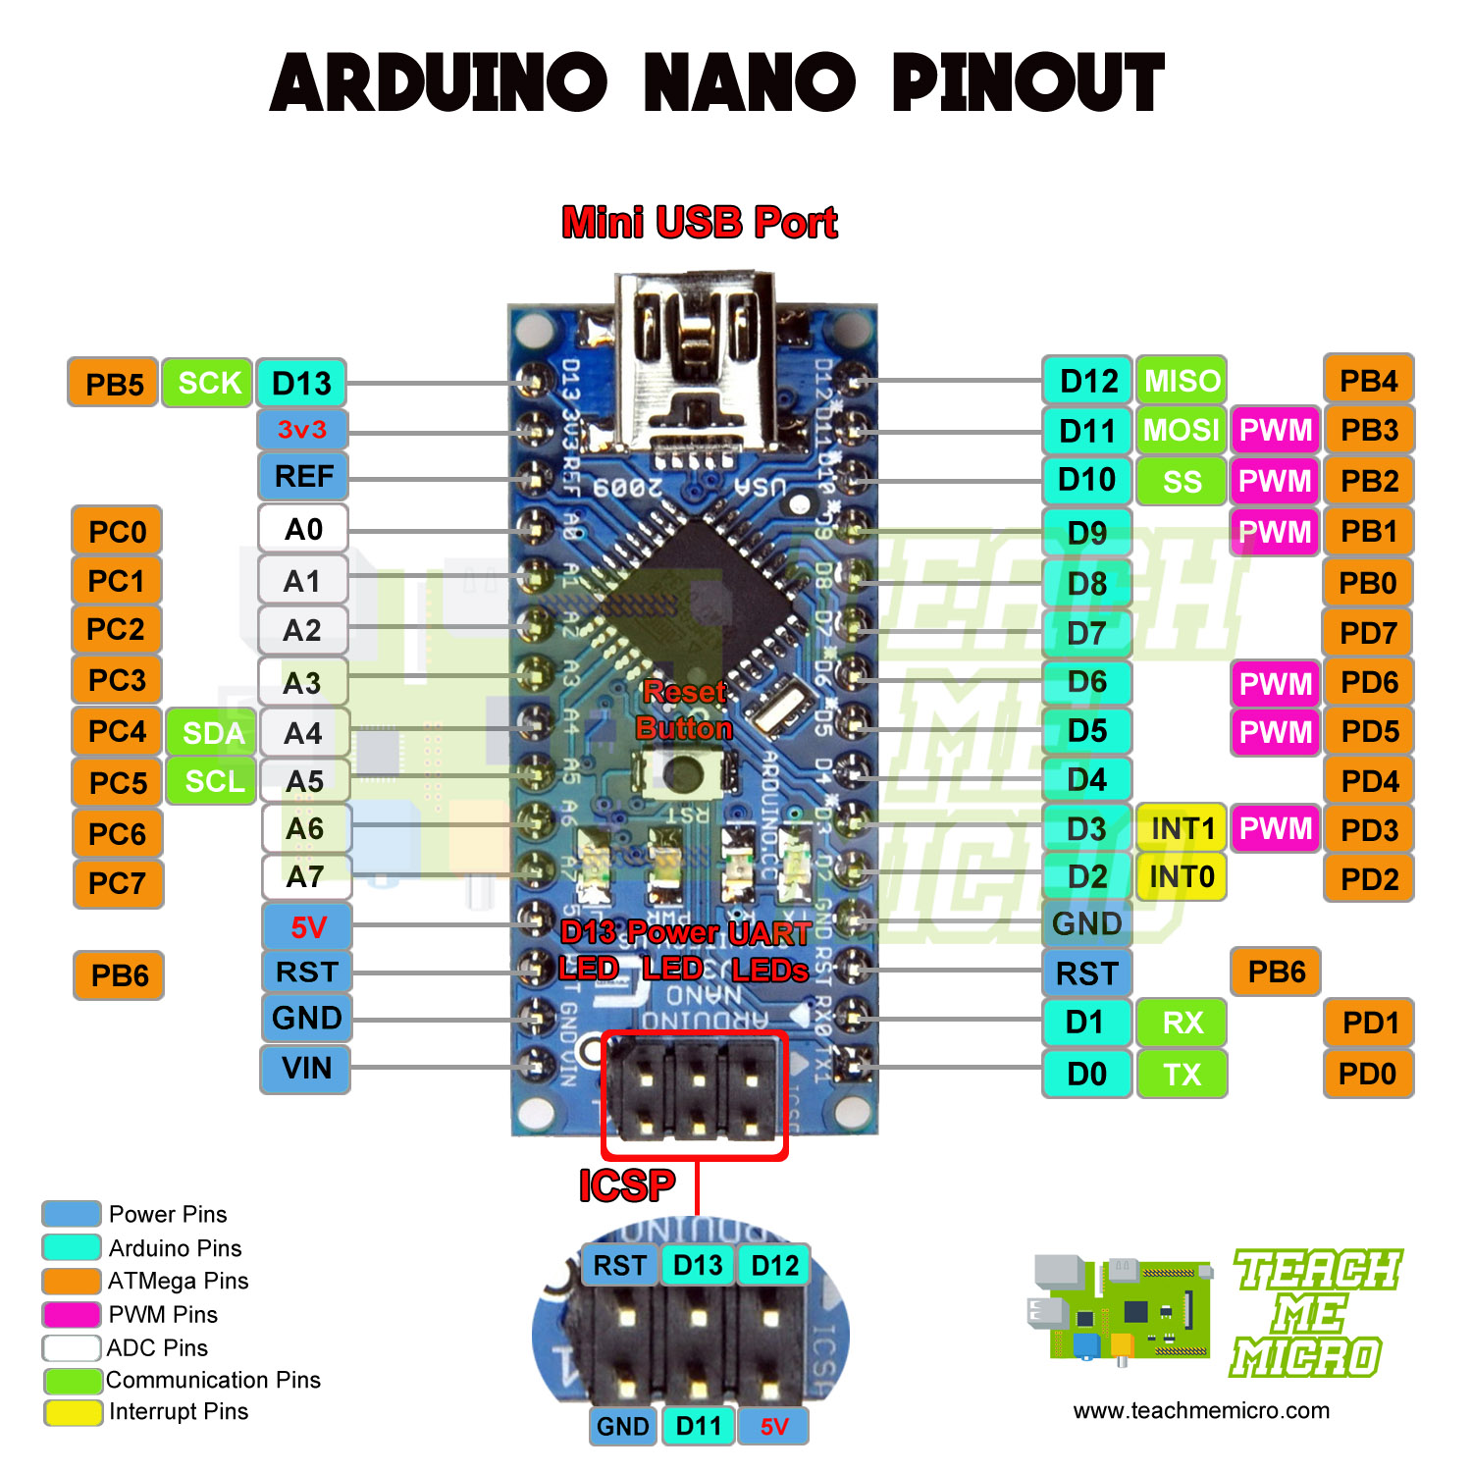

Slide 11
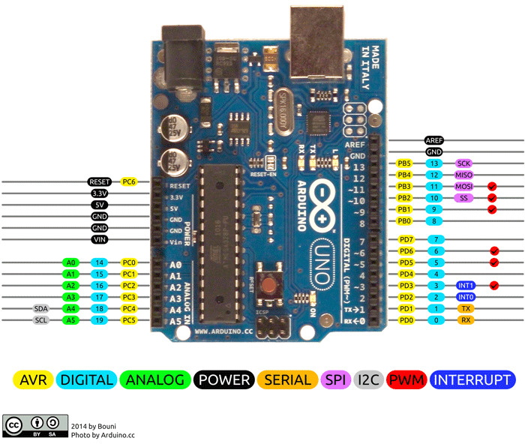

Slide 12
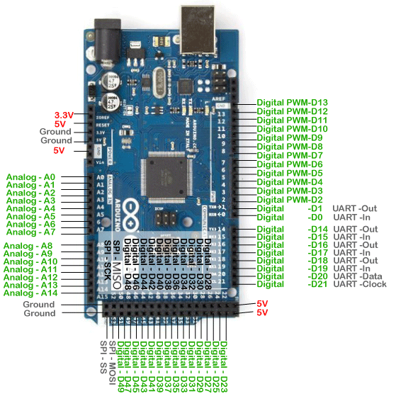

Slide 13
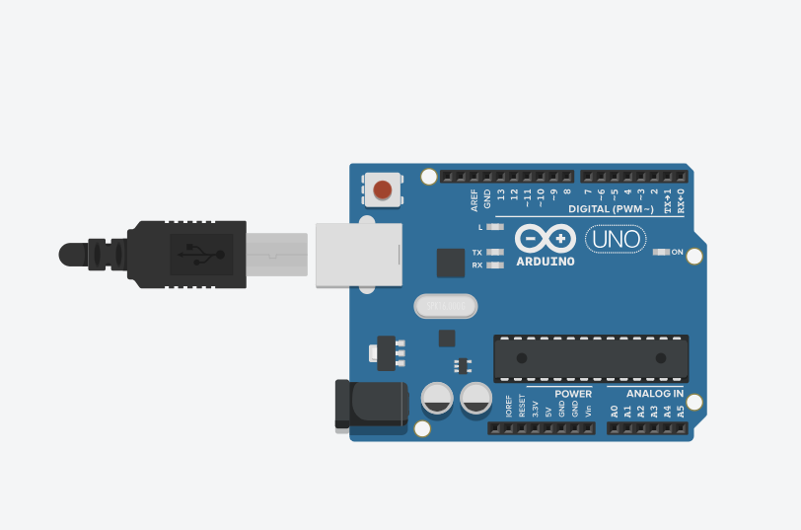
Blink Led
// C++ code
//
void setup()
{
pinMode(LED_BUILTIN, OUTPUT);
}
void loop()
{
digitalWrite(LED_BUILTIN, HIGH);
delay(1000); // Wait for 1000 millisecond(s)
digitalWrite(LED_BUILTIN, LOW);
delay(1000); // Wait for 1000 millisecond(s)
}

Slide 14
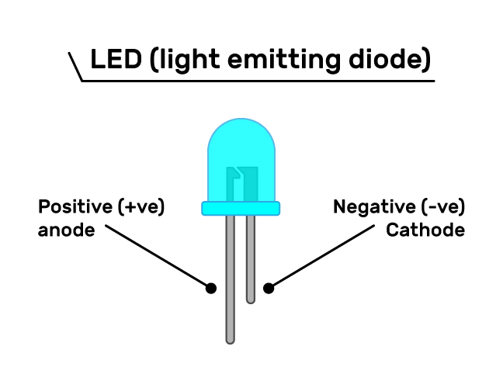
LEDS

Slide 15
Let’s start by controlling leds
// the setup function runs once when you press reset or power the board
void setup() {
// initialize digital pin LED_BUILTIN as an output.
pinMode(13, OUTPUT);
}
// the loop function runs over and over again forever
void loop() {
digitalWrite(13, HIGH); // turn the LED on (HIGH is the voltage level)
delay(1000); // wait for a second
digitalWrite(13, LOW); // turn the LED off by making the voltage LOW
delay(1000); // wait for a second
}

Slide 16
Practice
Using Arduino and LEDs write code to make Chase Effect with 8 leds

